Slide 1
IPC and Systems calls

Slide 2

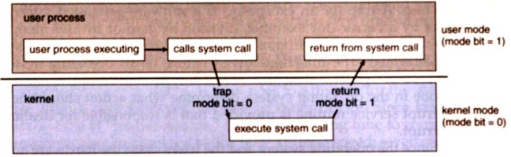
System Call
What is a system call?
A request from an application program for the operating system to perform some hardware action on behalf of the application.
System calls are initiated with a software interrupt assembly language instruction.

Slide 3
FD (fd – file descriptor)
0 – Standard input
1 – standard output
2 – Standard error
If open system call fails it returns -1

Slide 4
#include<unistd.h>
is typically made up largely of system call wrapper function as fork, pipe and I/O primitives (read, write, close, etc.).
int main()
{
int fd;
char buffer[80];
char msg[50] = "hello";
printf("fd = %d",fd);
if( )
{
printf("\n check.txt opened with read write access\n");
fd,
fd,
printf("\n %s was written to my file\n", buffer);
fd
}
return 0;
}
// file descriptor
#include<stdio.h>
Standard input and output
#include<fcntl.h>
file control options
fd =
open
( );
// open system call will give the value, that value will be the value for fd
"check.txt",
O_RDWR
3
fd!=-1
3!=-1
True
System call(s)
( );
msg,
msg
write
sizeof( )
fd,
( );
lseek
0
,SEEK_SET
msg
( );
read
buffer,
sizeof( )
close
( );

Slide 5
System Call
A service provided by the OS
Examples include, disk access, display services
System calls are exposed to user processes
Normally via C library interface, e.g. open

Slide 6
System Call
The library is an intermediary
Sits between user programs and the kernel
Calling the library does not, in itself, cause entry to the kernel
Normally, there will be an OS function, within the library that causes entry into kernel mode
The primary function of the library function is “configure” processor registers,
setup up the system call index (i.e. code) before calling the syscall function to enter the kernel

Slide 7
System Calls
System Call Parameters
Three general methods exist for passing parameters to the OS: Parameters can be passed in registers.
When there are more parameters than registers, parameters can be stored in a block and the block address can be passed as a parameter to a register.
Parameters can also be pushed on or popped off the stack by the operating system.

Slide 8
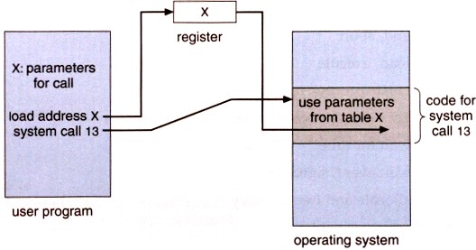
System Calls
System Call Parameters

Slide 9
System Calls
Types of System Calls
There are 5 different categories of system calls:
process control file manipulation
device manipulation information maintenance communication

Slide 10
Types of System Calls
Process Control
A running program needs to be able to stop execution either normally or abnormally. When execution is stopped abnormally, often a dump of memory is taken and can be examined with a debugger.
End, abort Load, execute
Create process, terminate process Get process, wait for time Allocate and free memory

Slide 11
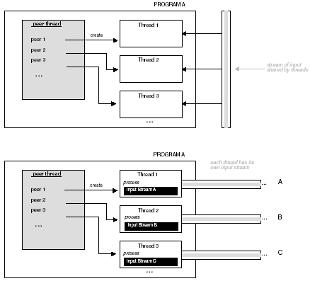
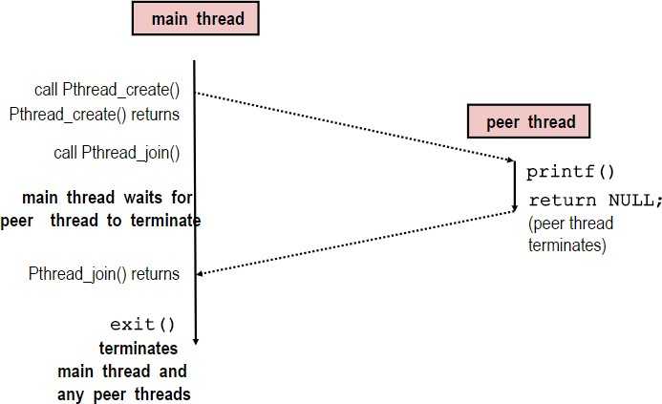
Pthreads example
Execution of Threaded ’hello, world’

Slide 12
System Call Implementation
Requires transfer of control from user mode to kernel mode
Implies a change of “privilege”, e.g. remember a process can only access its own address, while the kernel can see and change all Typical implementation is to use a software interrupt
All interrupts transfer control to the OS!
About 300 in count: listing in /usr/include/asm/unistd.h
Serve three purpose:
Provide an Abstracted h/w interface for user space Ensures system security and stability
Makes process management easier

Slide 13
Interprocess Communication and Synchronisation
IPC
Individual processes or threads to collaborate. OS provides IPC to processes.
For a single individual this might not seem to hard
Necessary that the operating system provides synchronization facilities.

Slide 14
IPC and Synchronisation
Interprocess Communication (IPC)
Example of interprocess and interthread communication facilities include:
data transfer, shared memory, message.
Data transfer:
Pipes (named, dynamic - shell or process generated) Shared buffers or files
TCP/IP socket communication (named, dynamic - loop back interface or network interface)

Slide 15
IPC and Synchronisation
Interprocess Communication (IPC)
Shared memory:
Between Processes
Between Threads (global memory)
Messages:
OS provided message passing: send() / receive()
Signals
Via locks, semaphores or monitors

Slide 16
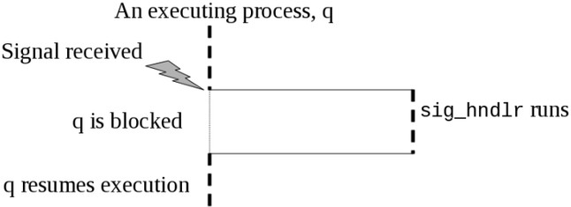
IPC
Handling Signals
Example:
Signals other than SIG KILL and SIG STOP may be caught and execute a defined signal handler function.

Slide 17



IPC
Potential IPC problems one
Starvation, when multiple processes/threads compete for access to a shared resource.
Deadlock, it occurs when two processes need multiple shared resources at the same time in order to continue.
Two pirates are in deadlock because neither is willing to give-up what the other pirate needs.

Slide 18
IPC
Potential IPC problems two
Data inconsistency, when shared resources are modified at the same time by multiple processes, data errors or inconsistencies may occur.
Shared buffer problem Read

Slide 19
IPC
Synchronisation Facilities
The solution to cooperating processes sharing resources without encountering the Potential Interprocess Communication Problems is to take advantage of Operating System provided synchronization facilities.
Potential synchronization solutions
How the Programmer can use synchronization facilities

Slide 20
IPC
Possible Synchronization Solutions
A semaphore, s is a non-negative integer variable that can only be changed or tested by these two invisible functions
V(s): [ s = s + 1]
P(s): [ while (s == 0) WAIT(); s = s - 1]
P (probern – to test) is used for acquiring the lock.
V (verhogen – to increment) is used for releasing the lock.
The square brackets [ ] here mean that the actions between the brackets is to be autonomous (not interruptible).
The initial value of s determines how many simultaneous threads may hold the semaphore lock.
Set s to 1 for a simple lock, called a binary lock or binary semaphore. Some problems allow for s to be larger than 1.

Slide 21
To manage concurrent process using simple integer value to solve SYNC problems
Semaphore is a variable which holds an integer value shared between threads to achieve SYNC in a multiprocessing environment
S and its value is used and accessed wait() and signal()
Represented by p for wait() and v for signal()
Wait() for decrement and signal() for increament

Slide 22
P(semaphore S)
{
While(S<=0);
S--;
}
If true the control will be inside the loop and will not come out
Means some other process are already in the Critical region or using the resource
Means the trying process will not be allowed to enter the critical region or share the resource

Slide 23
If the condition is not true, it will not go to while, rather go to the decrement, will let the other process to use the critical region or access the resource
Singal()
V(Semaphore S)
{
S++
}
Means when one process is modifying the value of semaphore the other process are not allowed to modify

Slide 24
Type one semaphore
Binary semaphore (0/1)
0 means critical region / resource used by a process
1 means the critical region / resource is free to be used other process
Case 1:
If the it is 1 means free and some process are to occupy

Slide 25
P(semaphore S)
{
While(S<=0);
S--;
}
P(semaphore S)
{
While(1<=0); // false
S--; // S = S -1 => S = 1 -1 = 0 // A process has occupied it
}

Slide 26
Case 2:
To leave a critical region
Now S = 0
Singal()
V(Semaphore S)
{
S++ // S = S +1 => S = 0 + 1 = 1 // Any process can occupy the critical region
}

Slide 27
Counting semaphore
Values are unrestricted 0,1,2,3,4…
Resources having multiple instances
R1 & R2
Three process P1, P2 & P3
P1
P(semaphore S)
{
While(S<=0); // (2<=0) // 2 is the instance the condition is False
S--; // S = S -1 => S = 2 -1 = 1
}

Slide 28
P2
P(semaphore S)
{
While(S<=0); // (1<=0) condition is False
S--; // S = S -1 => S = 1 -1 = 0
}
P3
P(semaphore S)
{
While(S<=0); // (0<=0) condition is True, the resource is in use
}

Slide 29
If any process like p1 or p2 is completed they will call the wait()

Slide 30
IPC
Semaphores
OS kernel guarantees that operations between brackets [ ] are executed indivisibly
Only one P or V operation at a time can modify s
When while loop in P terminates, only that P can decrement s
Semaphore invariants: (s > 0 )

Slide 31
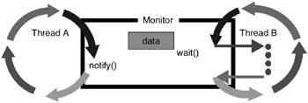
Synchronisation Facilities
Monitor
Conditional waits or conditional monitors: the s provides a foundation for implementing solutions to synchronization. An alternative monitors can allow for a simpler solution.
mutual exclusion lock and methods for a process to wait() until another thread issues a notify() method to awake the thread.
The key to correctly using a monitor is to always put the wait()
operation inside a while loop as shown below.

Slide 32

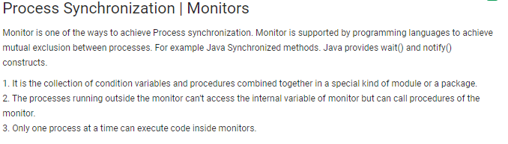
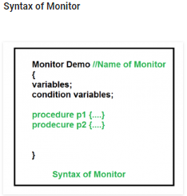

Slide 33
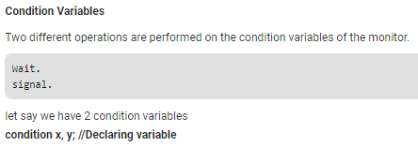
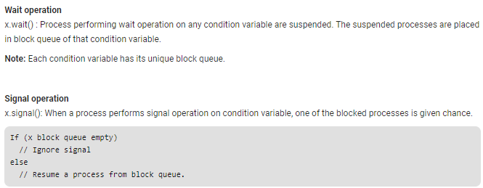

Slide 34
Thank you

